Slide 1

A Confidence-Driven Probabilistic Machine Learning Framework for Electricity Demand–Supply Gap Forecasting and RAG-Based Energy Planning
Tamilarasu D (Reg no: 43120224)
UdayaKumar S(Reg no: 43120227)
Suganth Kesavan(Reg no: 43120216)
Guide:
Dr. Kamatchi K S, Associate Professor

Slide 2
02
Presentation Agenda
01 Introduction & Background
08 Resources & Risk Assessment
02 Problem Statement
09 Proposed System Overview
03 Aim, Objectives & Scope
10 Methodology Flow Chart
04 Expected Outcomes
11 Materials, Methods & Data Analysis
05 Literature Survey
12 Validation, Timeline & Budget
06 Research Gap Analysis
13 Phase II & Future Work
07 Feasibility Analysis

Slide 3

03
Introduction & Background
ELECTRICITY DEMAND
Electricity demand changes based on weather, seasons, time, and other factors, so accurate forecasting is important for better energy planning and power supply.
Critical Need: Accurate forecasting helps in planning electricity supply in advance and making better decisions
ELECTRICITY SUPPLY
Electricity generation and supply may not always match the actual demand, creating challenges for grid management.
Consequences: Supply shortages can cause power disruptions, while excess supply can lead to energy wastage.
GAP
PROBABILISTIC GAP ANALYSIS
This project independently forecasts demand and supply, then analyzes the gap using prediction intervals to support better grid planning and energy dispatch.

Slide 4

04
Problem Statement
Limitations of Traditional Forecasting
01
Traditional forecasting usually predicts electricity demand alone and does not consider future supply. Since demand and supply are not predicted separately and compared together, it becomes difficult to know whether the grid will face a shortage or surplus.
02
A single predicted value does not show how uncertain the forecast is. Without a prediction range, energy planners cannot clearly understand the possible worst-case shortage or surplus and prepare accordingly.
Traditional systems only give forecast numbers and do not turn them into clear, practical energy planning suggestions.

Slide 5
05
Aim, Objectives & Scope
Machine-learning framework for forecasting electricity demand-supply gaps and risk classification
Key Project Objectives
Core Framework Aim
Our system predicts future electricity demand and supply, finds the shortage or surplus, measures the uncertainty, identifies the risk level, and gives useful planning suggestions.
Clean the old electricity data and other related data before using them for prediction.
We test different ML models and compare their performance to find which one works better
After predicting both values, we subtract supply from demand.
Instead of giving only one predicted number, we give a range showing where the actual value is likely to fall.
Project Scope
We use past electricity data to build the models, calculate prediction ranges, and retrieve relevant information to provide energy planning suggestions.
We set limits for the demand-supply gap and use them to determine the risk level.
Utilizing a Retrieval-Augmented Generation engine for policy-grounded plans.

Slide 6
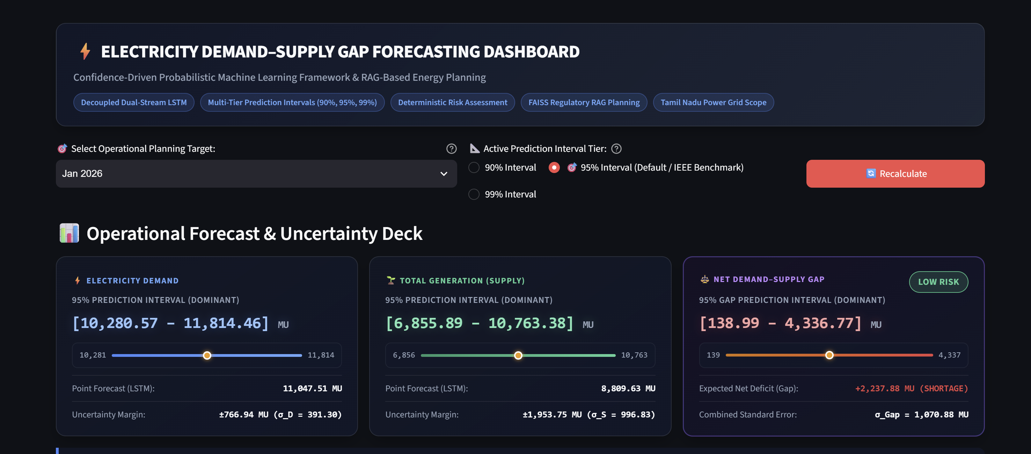
Expected Outcomes
06

Slide 7
07
Literature Survey
Academic Review of Previous Research
Author / Year
Method / Model
Application Domain
Major Finding
Identified Limitation
Chisale et al. (2025) [5]
ECEEMDAN-BiGRU & Quantile Regression
Electricity Demand Forecasting
Signal decomposition effectively extracts non-linear trends; quantile regression yields robust demand intervals.
Focuses exclusively on demand; completely omits supply-side forecasting and gap estimation.
Cao et al. (2022) [15]
Transformer-Guided State Space (TPEDF)
Probabilistic Demand Forecasting
Transformer attention captures long-term dependencies while state-space modeling quantifies uncertainty distributions.
Single-side forecasting; lacks demand-supply integration and actionable decision support.
Terrón-Serrano et al. (2026) [13]
Shared Probabilistic Distributions
Day-Ahead Demand & Renewables
Joint probabilistic modeling of load and renewables using weather data improves reserve scheduling efficiency.
Does not compute operational gap intervals or incorporate RAG-based regulatory planning.
Ni et al. (2024) [16]
ChatGrid: LLM + RAG Pipeline
Power Dispatching Knowledge Q&A
Retrieval-Augmented Generation grounds LLM answers in grid dispatch rules, dramatically cutting hallucinations.
Standalone conversational Q&A system; lacks integration with numerical ML forecasting engines.
Debnath et al. (2025) [29]
Weather-Informed LSTM & Transformer
Extreme Weather Grid Load Forecasting
Incorporating multi-source weather variables (temperature, humidity) significantly reduces peak load forecast errors.
Deterministic point predictions only; no confidence intervals or supply-gap risk assessment.
Literature Survey – Electricity Demand–Supply Gap Forecasting

Slide 8
08
Research Gap Analysis: Conventional vs Proposed Framework
Evaluation Dimension
Existing Approaches
Proposed Framework
Research Gap Addressed
1. Forecasting Scope
Forecasts demand or supply in isolation (siloed models)
Decoupled, synchronized dual-stream forecasting (Demand + Supply)
Eliminates operational mismatch between generation and load
2. Prediction Nature
Deterministic point forecasts (single values)
Confidence-driven probabilistic forecasting with multi-level bounds
Quantifies prediction uncertainty for tail-risk management
3. Prediction Intervals
Rarely implemented, or single-level (e.g., 95% only)
Multi-level 90%, 95%, and 99% symmetric prediction intervals
Offers customizable risk tolerance margins for SLDC operators
4. Demand–Supply Gap
Heuristic or post-hoc comparison without uncertainty
Dedicated mathematical gap engine with combined sigma_G propagation
Provides rigorous statistical confidence bounds for net deficit/surplus
5. Risk Assessment
Manual, ad-hoc threshold inspection by engineers
Deterministic 3-tier severity classification (Low, Moderate, High)
Standardizes automated dispatch alerts and operational priority
6. Energy Planning
Disconnected static rulebooks or ungrounded LLMs
Integrated RAG engine with FAISS vector retrieval & grounded LLM
Bridges numerical forecast outputs directly to policy-grounded actions

Slide 9
09
Feasibility Analysis
Technical, Economic, Operational, and Environmental Assessment
TECHNICAL FEASIBILITY
Built entirely on Python, utilizing open-source ML libraries (Scikit-Learn, LightGBM, TensorFlow), a Streamlit GUI, and reliable vector DB technologies.
ECONOMIC FEASIBILITY
The project uses free and open-source tools and publicly available energy datasets, so the development cost is low.
OPERATIONAL FEASIBILITY
Features a simple, interactive dashboard designed specifically for grid operators to interpret probabilistic graphs and clear text recommendations.
ENVIRONMENTAL FEASIBILITY
The system can help reduce energy waste and emissions by supporting better power generation and scheduling decisions.

Slide 10
10
Resources & Risk Assessment
System Requirements and Algorithmic Vulnerability Mitigations
RESOURCE REQUIREMENTS
RISK MATRIX & MITIGATIONS
Missing/Inconsistent Grid Data
Some energy data may be missing or incorrect. We handle this using data-cleaning and missing-value methods.
HARDWARE SPECIFICATION
A standard computer with at least 16 GB RAM, 512 GB storage, and a modern multi-core processor is sufficient for model training and application deployment.
High Forecast Volatility
Future electricity values may vary. We use 90%, 95%, and 99% prediction intervals to show the possible range
SOFTWARE ENVIRONMENT
Software includes Python, Scikit-learn, XGBoost, LightGBM, TensorFlow, Streamlit, and Vector DB APIs.
Out-of-sample Generalization Errors
The model may not work well on unseen data. We test it using January–March 2026 data to check its performance.
Hallucinated LLM Guidance
The AI may give incorrect suggestions. We use RAG with trusted energy-policy documents to provide reliable recommendations.

Slide 11
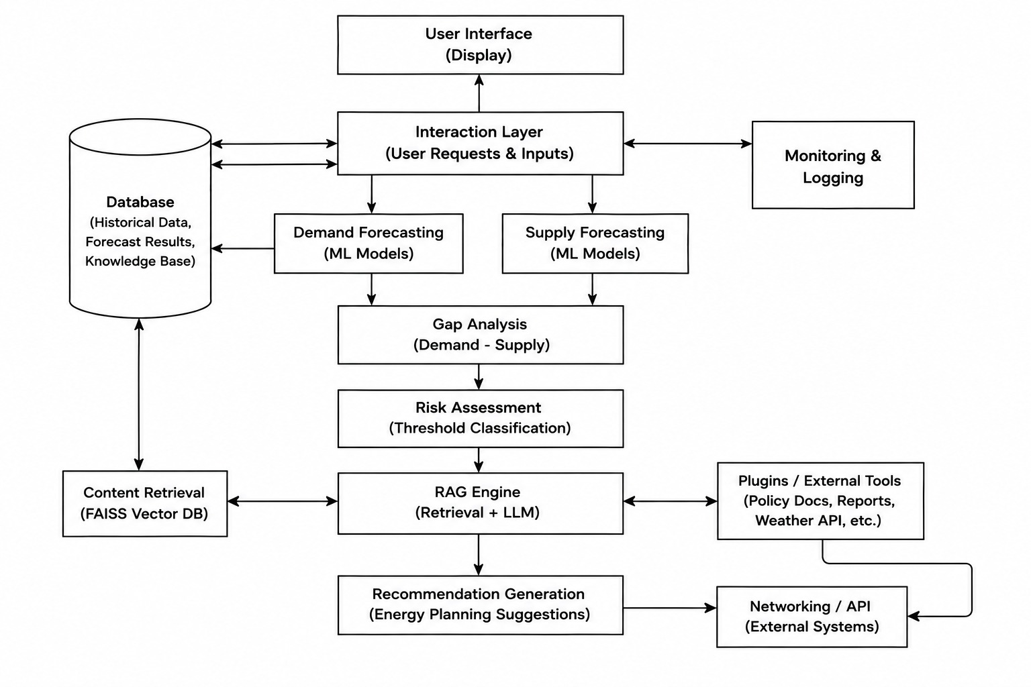
Proposed System Overview
11
Parallel Pipeline and RAG Architecture

Slide 12
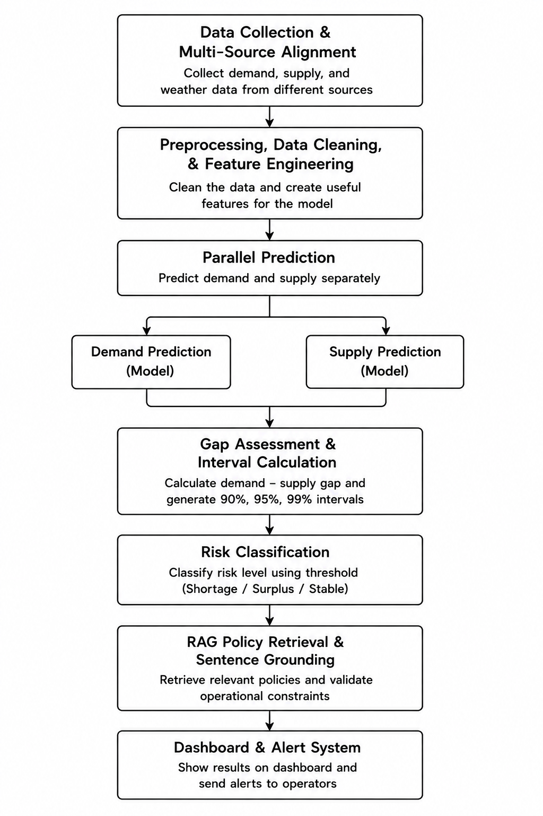
12
Methodology Flow Chart
Sequential Implementation Pipeline
01Data Collection & Multi-Source Alignments
Demand, Supply, and Weather environmental data streams integrated
02Preprocessing, Data Cleaning, and Feature Engineering
Cleaning raw historical sequences and structuring predictive model features
03Parallel Execution: Independent Demand & Supply Predictions
Highly decoupled multi-track model processing before synthesis
04Probabilistic Gap Assessment & Interval Calculations
Quantifying forecast variance and computing system margin boundaries
05Categorical Risk Classification (Shortage, Surplus, Stable)
Assigning actionable states based on probabilistic threshold limits
06RAG Policy Knowledge Retrieval & Sentence Grounding
Retrieving contextual regulatory rules and validating operational constraints
07Final Dashboard Rendering and Operator Alert System
Presenting real-time decisions and executing alert dispatch loops

Slide 13
13
Materials, Methods & Data Analysis
Models, Metrics, and Formulae
Modeling Architectures
Probabilistic Calibration
Random Forest
XGBoost
Leverages bootstrapped residuals to generate robust, multi-tier confidence bounds for uncertainty estimation.
LightGBM
Deep LSTM
90%
Confidence
95%
Confidence
99%
Confidence
Evaluation Metrics
Gap Mechanics
RMSE
MAE
MAPE
R²
Gap = Predicted Demand - Predicted Supply
POSITIVE GAP (+)
Power Shortage Risk
Forecasted demand exceeds generation capacity.
NEGATIVE GAP (-)
Energy Surplus
Over-generation relative to system load demand.

Slide 14
14
Validation, Timeline & Budget
Performance Validation and Project Management
Validation Strategy
Out-of-Sample Validation utilizes unseen January-March 2026 actual observations to measure prediction interval coverage probability (PICP).
Budget Summary
Development costs are minimal, relying entirely on open-source packages and standard cloud computing tiers.
Month 1-2
Literature Survey & Data Preparation
Month 3-4
Modeling & Parallel Benchmarking
Month 5
Interval Calibration & RAG Architecture
Month 6
Dashboard Development, Validation, and Documentation

Slide 15
15
Phase II & Future Work
Strategic Future Horizons
Accuracy Upgrades: Integrate real-time geographic telemetry and advanced transformer models.
Thank You
Calibration Tuning: Implement dynamic conformal prediction to make intervals highly robust to unexpected weather anomalies.
Policy Expansion: Expand local vector databases with regional grid regulations.
Production Deployment: Move Streamlit deployment to cloud enterprise architectures with automated weekly retraining loops.

